Slide 1
DDS Design with Chisel

Slide 2
DDS Design with Chisel
Introduction to Direct Digital Synthesizer (DDS)
DDS Architecture Overview
Development Workflow
Python Model Implementation
Python Simulation Results
Chisel-Based DDS Design
Integration with TheSydeKick
Chisel Simulation Results
Python vs Chisel Comparison
Performance and Resource Analysis

Slide 3
DDS Design with Chisel
Lessons Learned and Future Work
Conclusion

Slide 4
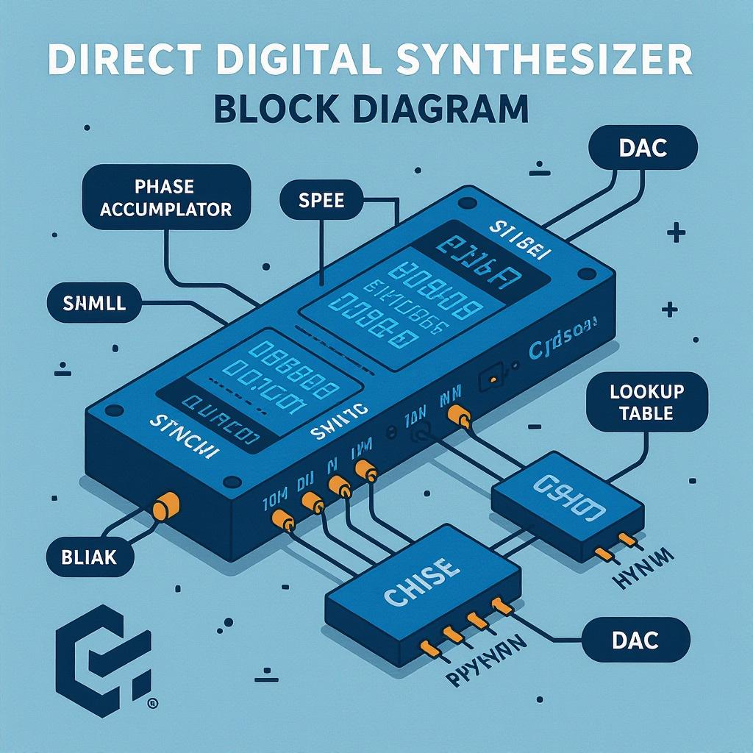
Introduction to Direct Digital Synthesizer (DDS)
Fundamental DDS Mechanism: DDS generates arbitrary waveforms digitally via phase accumulation plus waveform lookup tables enabling precise synthesis.
Application Domains: Common in digital communication, signal generation, radar, and instrumentation due to versatility and accuracy.
Advantages Over Analog: Offers high precision frequency control, programmable tuning words, and compact hardware compared to analog alternatives.
Generated on AIDOCMAKER.COM

Slide 5
DDS Architecture Overview
Phase Accumulator Function: Phase accumulator increments by tuning word each cycle, determining phase angle for waveform synthesis precisely.
Lookup Table Role: LUT stores discrete waveform samples like sine values, enabling real-time phase-to-amplitude conversion efficiently.
DAC Output Generation: DAC converts digital amplitude from LUT into continuous analog signal, realizing final output waveform synthesis.

Slide 6
Development Workflow
Behavioral Simulation with Python and TheSydeKick: Conduct high-level verification by modeling DDS behavior using Python and TheSydeKick frameworks for early validation.
Hardware RTL Design in Chisel: Translate verified Python model to Chisel-based RTL design emphasizing modularity and hardware synthesis constraints.
Iterative Validation and Refinement: Continuously validate simulations against hardware models, refining design for accuracy, performance, and correctness.

Slide 7
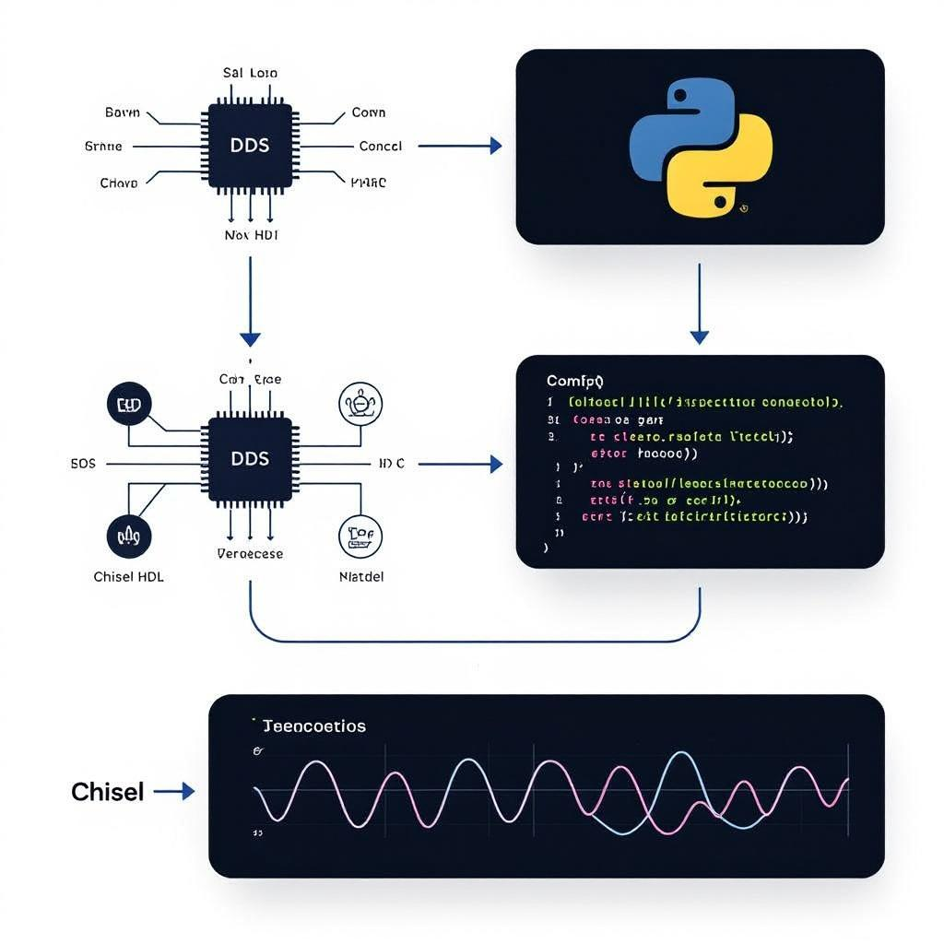
Python Model Implementation
Tuning Word Calculation: Python computes tuning words by scaling desired frequency to phase accumulator resolution for accurate frequency control.
Phase Accumulation and Wrapping: Implements modulo arithmetic to wrap phase accumulator values, ensuring continuous cyclic phase progression in simulation.
Multi-Waveform LUT Indexing: Uses phase index to retrieve samples from dedicated LUTs supporting sine, square, and triangle waveform generation efficiently.
Generated on AIDOCMAKER.COM

Slide 8
Python Simulation Results
Waveform Accuracy Assessment: Graphs demonstrate output waveform closely matches ideal sine shape validating simulation precision.
Noise Floor and Harmonic Distortion: Measured noise floor remains low with harmonic distortion quantified, confirming signal purity and spectral integrity.
Frequency Control Validation: Tuning word plotted against LUT index confirms linear phase increment and precise frequency synthesis capability.

Slide 9
Chisel-Based DDS Design
Modular RTL Componentization: The design modularizes phase accumulator and waveform generator, promoting maintainability and hardware reuse.
Fixed-Point Arithmetic Application: Utilizes fixed-point formats to represent phase and amplitude, balancing precision with silicon area and timing.
Performance Optimization Strategies: Optimizes latency and resource usage by pipeline stages and efficient fixed-point operations for high-frequency operation.

Slide 10
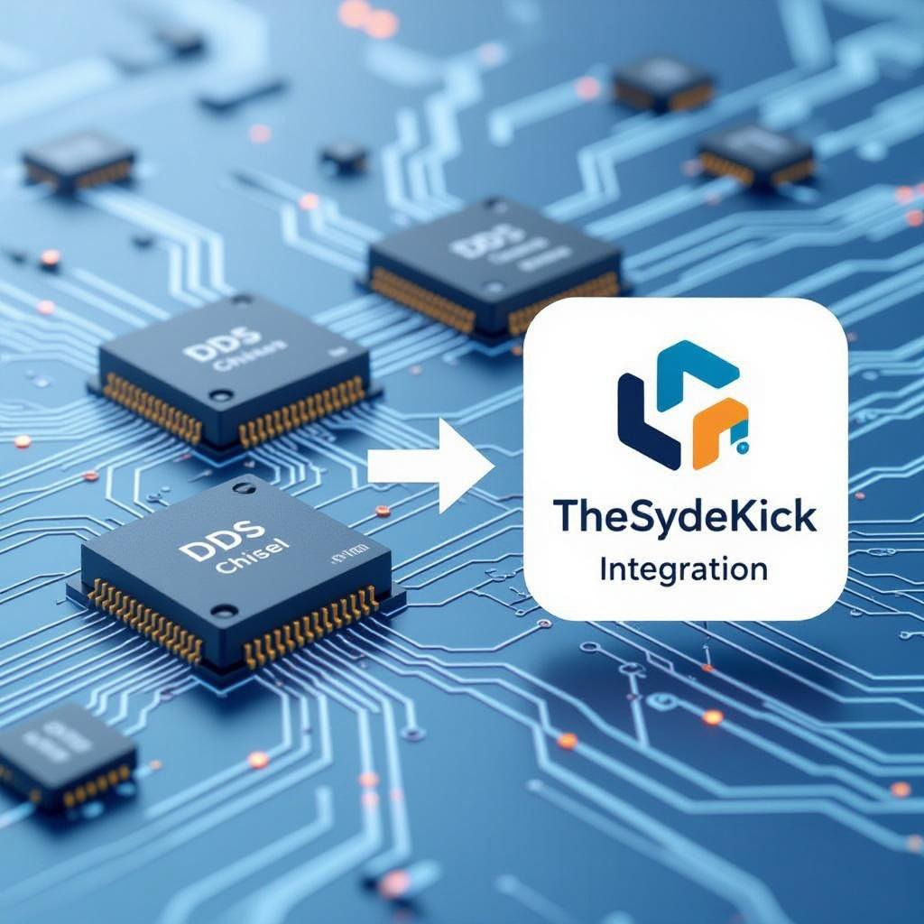
Integration with TheSydeKick
Co-Simulation Methodology: TheSydeKick synchronizes Chisel and Python simulations to ensure waveform generation consistency across models.
Automated Test Harness: Custom test harness exercises tuning words, phase increments, and output waveforms enabling robust automated verification cycles.
Behavioral Alignment Verification: Systematically compares output waveforms against Python reference, detecting discrepancies in phase and amplitude behavior precisely.
Generated on AIDOCMAKER.COM

Slide 11
Chisel Simulation Results
Tuning Word and Phase Tracking: Plots confirm linear tuning word progression aligning with expected phase accumulator increments per clock cycle.
Amplitude Output Fidelity: Waveform amplitude outputs closely match reference, demonstrating high accuracy in fixed-point amplitude representation.
Timing and Deviation Analysis: Minimal timing skew observed; minor artifacts attributed to quantization errors remain within acceptable error margins.

Slide 12
Python vs Chisel Comparison
Waveform Fidelity Assessment: Both models generate closely matching waveforms with minimal deviation in amplitude and phase resolution observed.
Timing Performance Discrepancies: Chisel simulation exhibits minor skew due to hardware timing constraints absent in Python's idealized execution.
Noise and Distortion Causes: Quantization and fixed-point truncation in Chisel introduce subtle noise not present in high-precision Python floats.

Slide 13
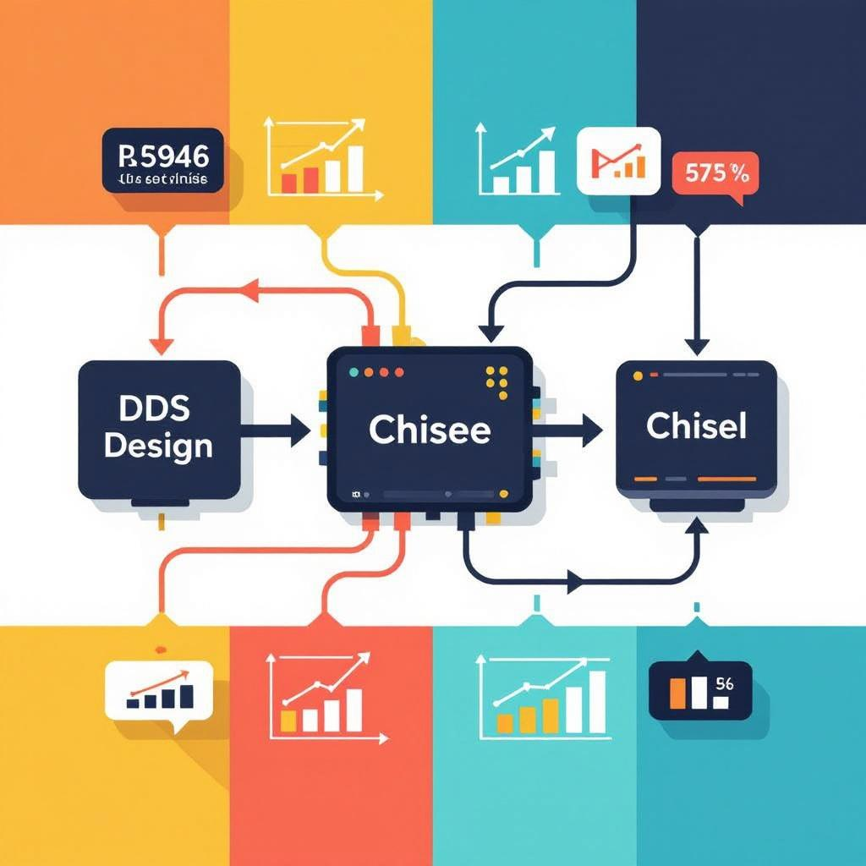
Performance and Resource Analysis
Area Utilization Metrics: Synthesis reports approximately 1,200 LUTs and 950 flip-flops consumed by the DDS design modules.
Latency and Frequency Trade-offs: Design achieves a 5-cycle latency with maximum clock frequency near 250 MHz balancing speed and accuracy.
Implementation Trade-off Considerations: Resource usage was optimized against frequency resolution by adjusting phase accumulator bit width and LUT size.
Generated on AIDOCMAKER.COM

Slide 14
Lessons Learned and Future Work
Fixed-Point Precision Challenges: Managing fixed-point formats required balancing precision needs with hardware resource constraints and timing closure.
Simulation and Integration Complexity: Integrating Chisel simulation with Python models exposed synchronization issues necessitating robust co-simulation frameworks.
Future Enhancements and Flexibility: Plans include supporting diverse waveforms, dynamic LUT loading, and leveraging Chisel's modularity for DSP hardware improvements.

Slide 15
Conclusion
Project Achievements: Successfully implemented DDS in Chisel with rigorous verification against Python behavioral models ensuring correctness.
Chisel and DDS Advantages: Chisel enables rapid RTL prototyping; DDS architecture offers precise, programmable waveform generation capabilities.
Application Potential: DDS design is applicable in digital communications, radar, instrumentation, and advanced signal processing systems today.

